Slide 1
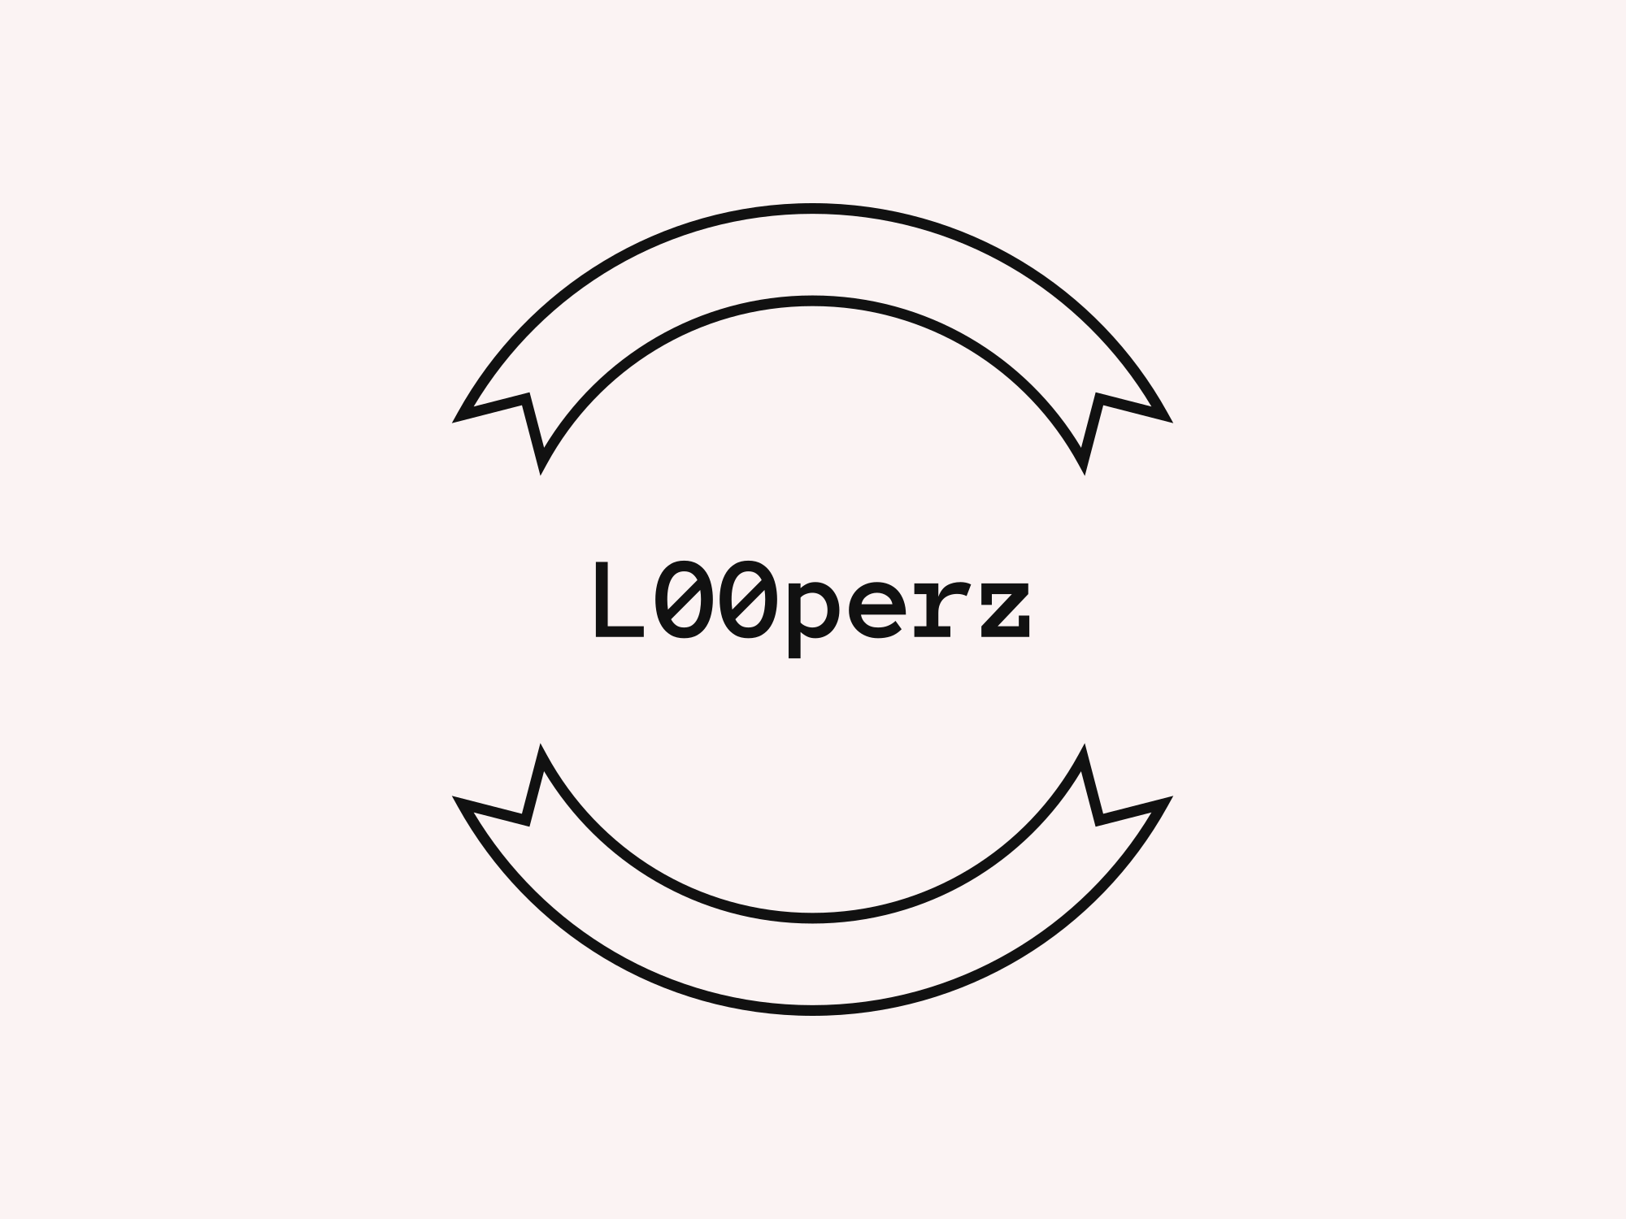
ΠΑΡΟΥΣΙΑΣΗ ΕΡΓΑΣΙΑΣ ΕΞΑΜΗΝΟΥ
2/2/2023
ΑΡΧΙΤΕΚΤΟΝΙΚΗ ΥΠΟΛΟΓΙΣΤΩΝ
ΒΡΕΤΤΟΣ ΠΑΝΑΓΗΣ
ΝΑΝΝΟΣ ΠΕΤΡΟΣ
ΤΣΑΝΤΕΡ ΝΤΑΡΑΜ

Slide 2
A FEW WORDS ABOUT THE ASSIGNMENT
As part of our studies at the IEK AKMI, we were assigned as a semester assignment in the computer architecture course to set up our own Windows Server by representing the conditions of a realistic working environment.
During the project we encountered several problems with the functionality of the Server. The solution to these problems was mainly the teamwork that pervades this team, patience, and of course the developer's best friend. Google! However, through the problems we encountered and the numerous attempts to solve them, we gained knowledge that will surely be a lifesaver in our later career.

Slide 3

Without further delay L00perz are presenting…

Slide 4
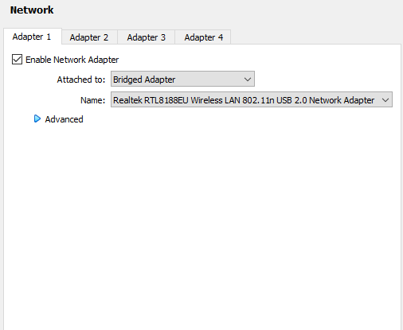
NAT NETWORK
BRIDGED NETWORK
A very important step before creating our virtual machines is to switch the network from NAT (network address translation) to Bridged Network on both machines. In this way we achieve the connection of the virtual machine to our network, its communication with all the devices on it and the communication between the machines, since they will have their own IP.

Slide 5
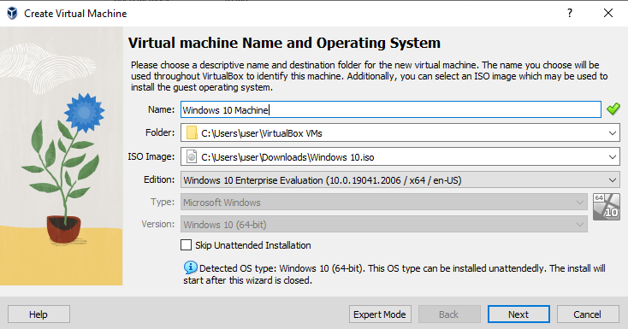
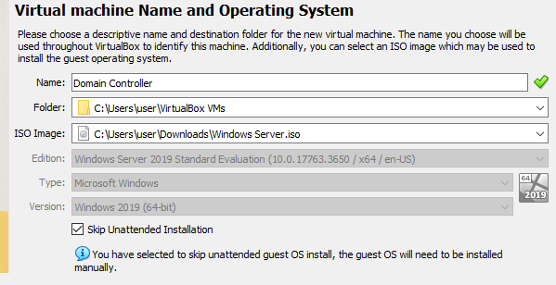
INSTALLING VIRTUAL MACHINES (ISO)
WINDOWS 10 MACHINE
WINDOWS SERVER 2019 MACHINE

Slide 6
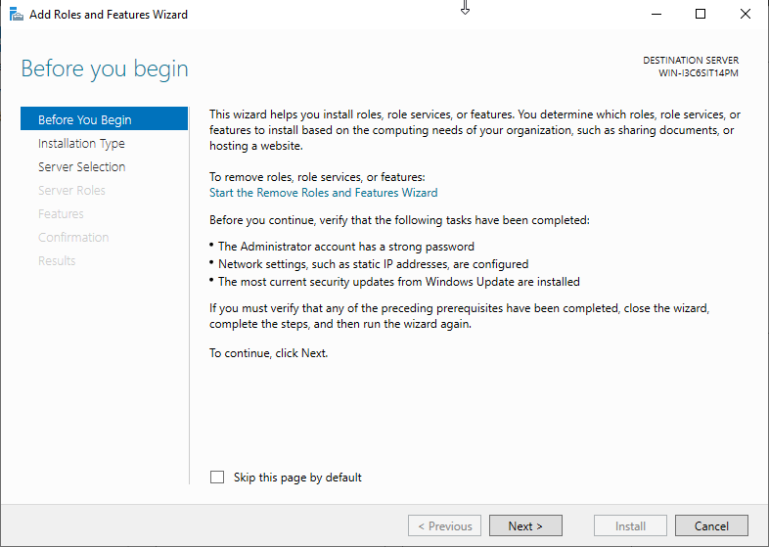
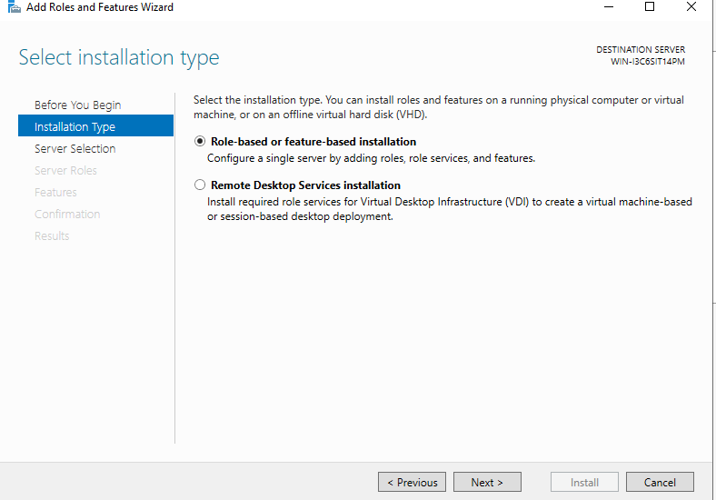
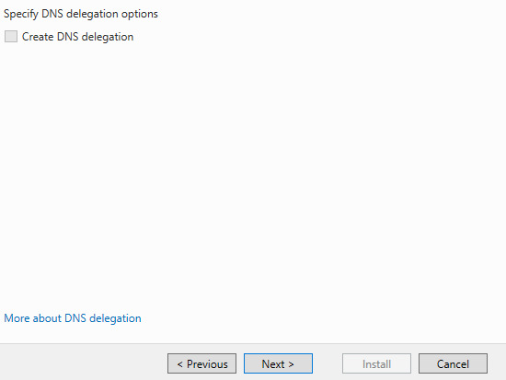
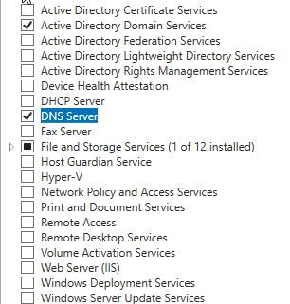
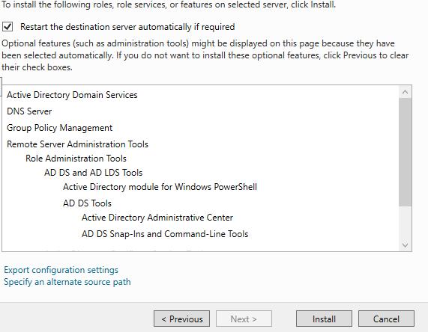
WINDOWS SERVER INSTALLATION
Downloading the windows server was not a major obstacle as we followed the Wizard and configured only a few options.
A very important configuration is the installation of the appropriate packages (Active Directory Domain Services / DNS SERVER) as without them our Server will not be able to become a Domain Controller.

Slide 7
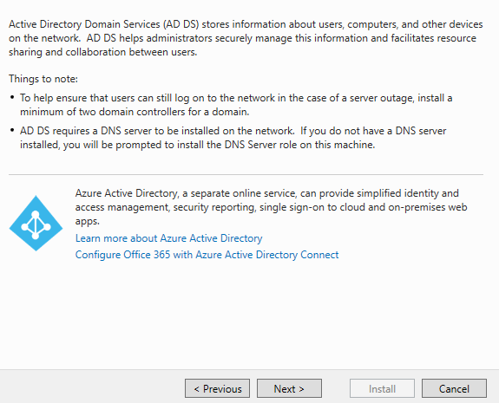
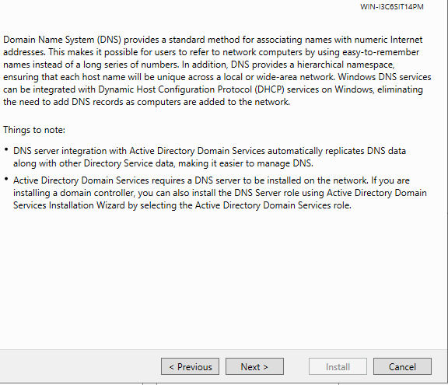
WINDOWS SERVER INSTALLATION
Arriving at the end of this wizard, we have fully configured our installation, having selected the appropriate services that will allow
us to turn our Server into a Domain Controller. (Active Directory Domain Services / DNS Server)
Active Directory Domain Services: It is the core of Active Directory and is what allows us to do the hierarchy of a Domain.
DNS SERVER SERVICES: Makes it possible to translate IP addresses to human readable forms.

Slide 8
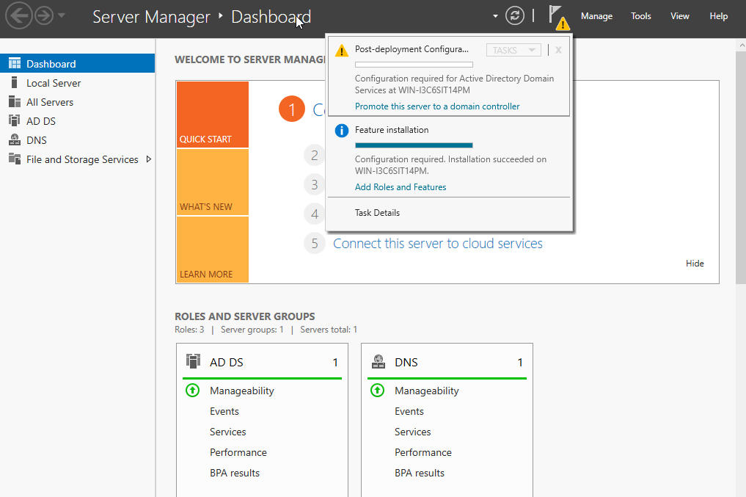
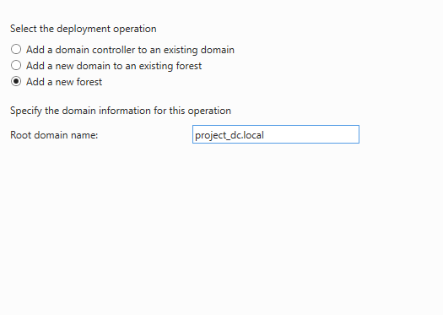
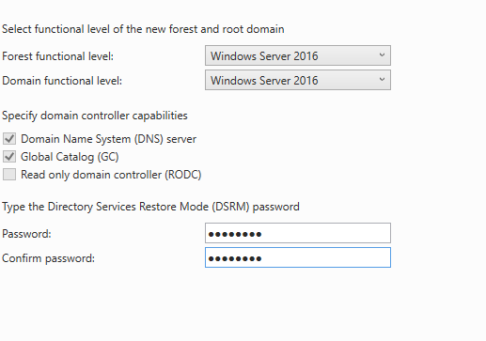
PROMOTING TO DC
After completing the first Wizard , we noticed that the long awaited notification was created that referring us to convert our Server to a Domain Controller. (Picture 1)
1
2
3
Then as shown in picture 2, we created a new forest, as this is the creation of the first Domain Controller ,
we named it "project_dc.local" and set a password as shown in picture 3.

Slide 9
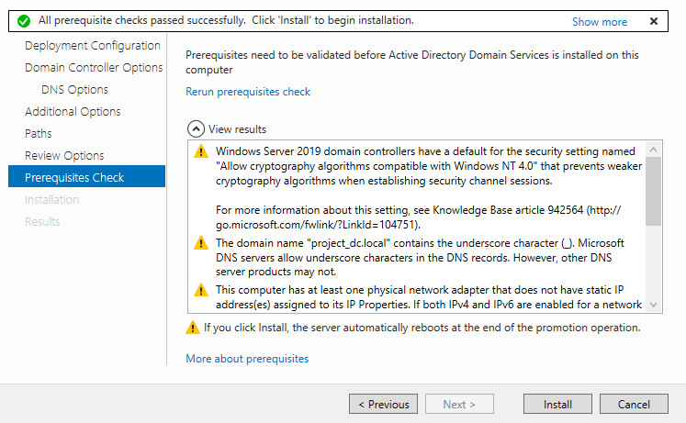
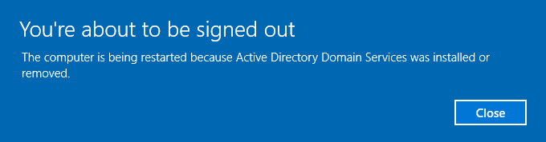
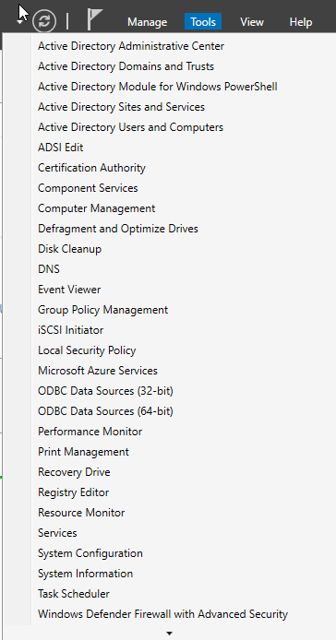
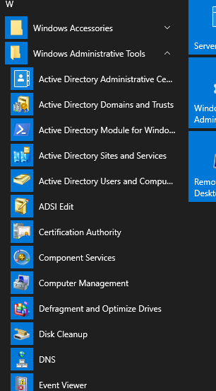
PROMOTING TO DC
By running the wizard of the service installation we were notified that our Server will be rebooted in order to implement
the installation, and finally be converted to a Domain Controller.
After the restart of the server, we now have the appropriate
tools to move on to the next steps of our assignment.

Slide 10
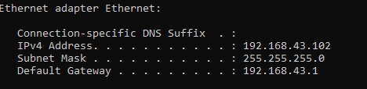
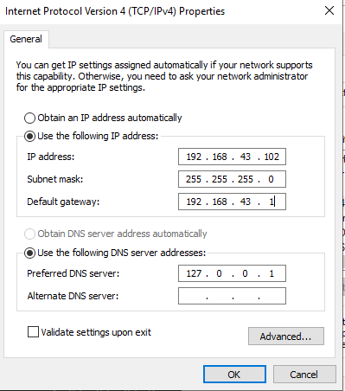
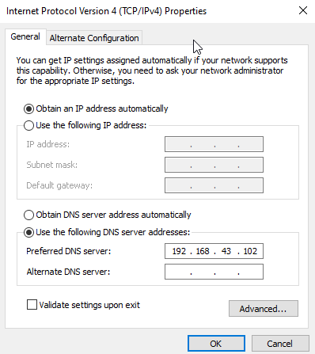
JOINING CLIENT TO DC
We are now ready to move on to the next phase of work which is none other than to Connect our other machine to the
Domain Controller, or "project_dc.local".
1
The first step we thought we could take is to make the DC’S IP static. So we ran the
ipconfig command in CMD and copied the addresses to the IPV4 properties.(1)
As a second step, we copied the static IP Address of our Domain and set it as the
DNS on the Client PC.(1)
2

Slide 11
JOINING CLIENT TO DC – 1st difficulty
The problem we were having was that neither the client nor the DC could ping each other.
So we couldn't move on to the next step of the task.
We tried changing the Network type from Virtual box, to all other types.
To reconfigure IPV4.
To make the DC's IP dynamic.
Until we realized that the IPv6 protocol was not disabled on either machines. And so , after an hour we resolved the first problem
/headache by disabling the IPv6 protocol.

Slide 12
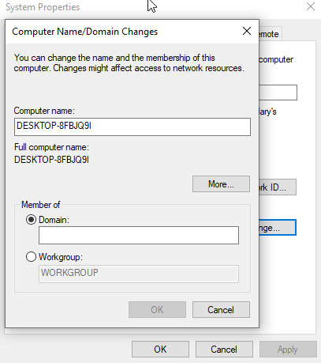
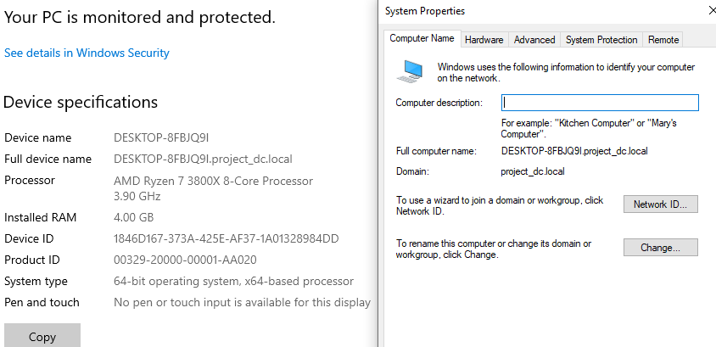
JOINING CLIENT TO DC
After disabling the IPv6 protocol, we were able to join the client to the DC successfully!

Slide 13
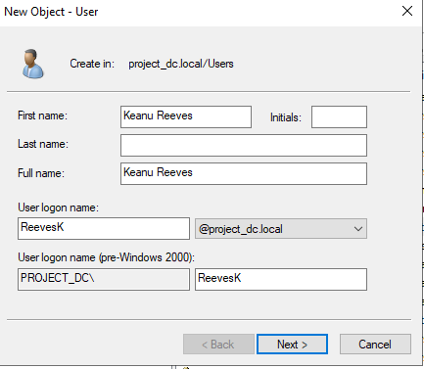
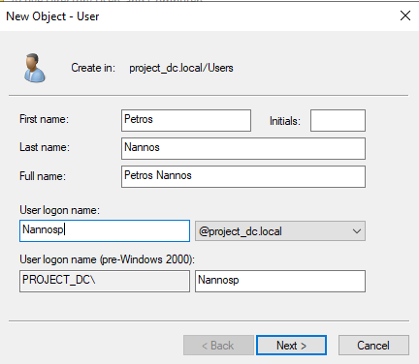
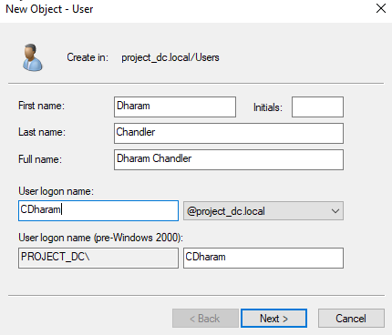
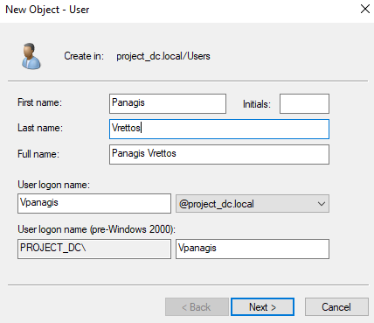
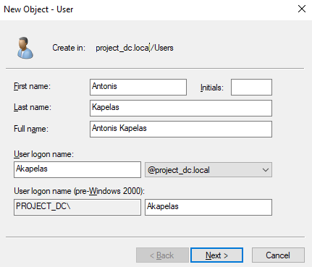
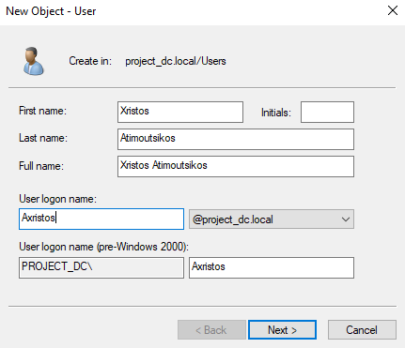
CREATING USERS
Having now joined the client to the DC it was time to create the 6 users using the active directory tools we pre-installed!
So that's how we created the 6 users.

Slide 14
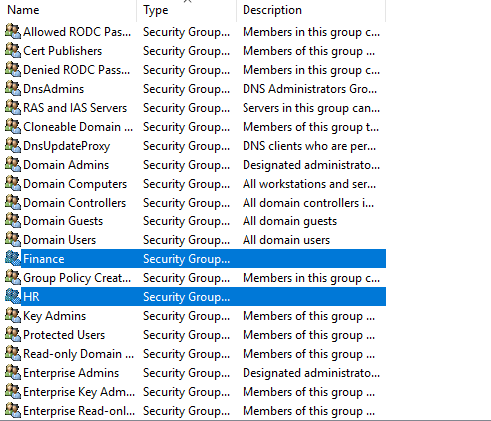
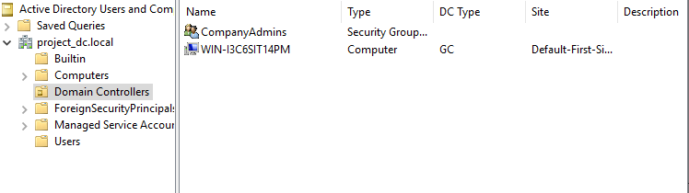
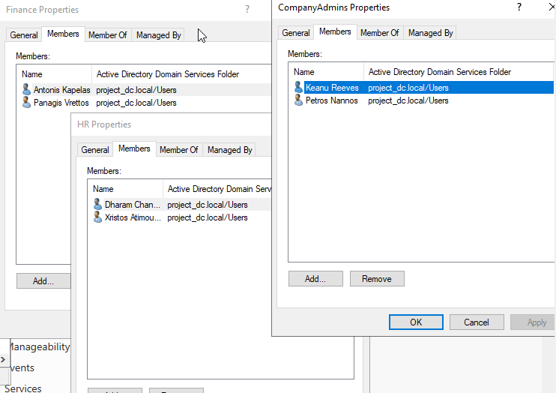
CREATING GROUPS
We created respectively all 3 groups , finance and HR and the company admins who have full management of the whole
domain! Each group consists of two users.

Slide 15
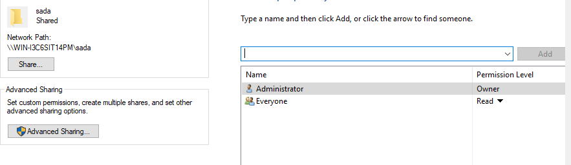

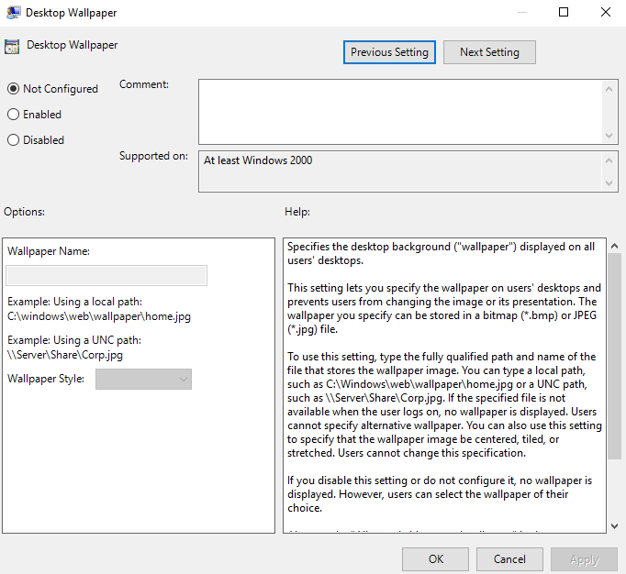
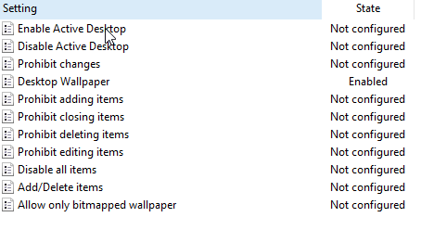
SHARING WALLPAPER GPO
We have successfully created the GPO for the shared wallpaper via group policy management, as well as the shared folder
that contained the wallpaper of our choice.
SHARED FOLDER
Group policy management
COMMON WALLPAPER GPO
DESKTOP WALLPAPER ENABLED

Slide 16
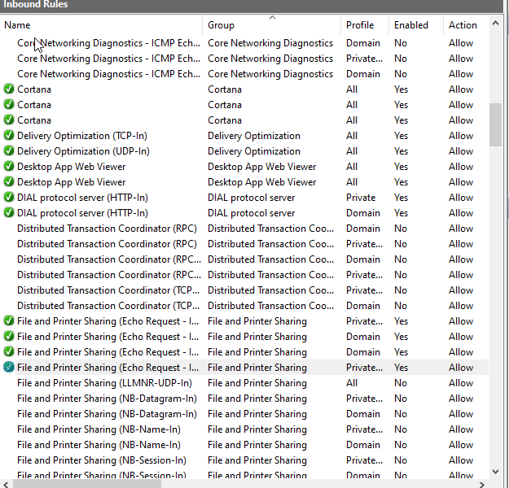
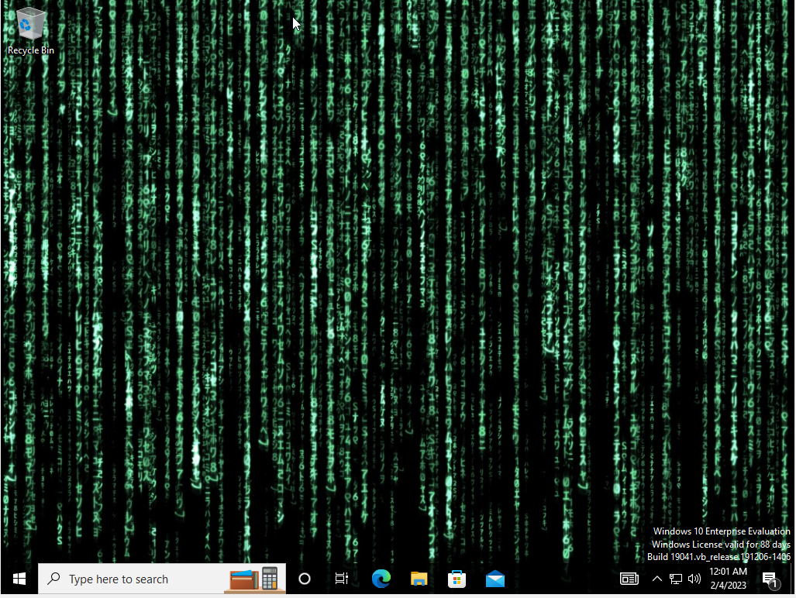
SHARING WALLPAPER GPO – 2nd difficulty
The second difficulty that arose was in making the Wallpaper change for all users. After we repeatedly took the steps of creating a
GPO and shared folder without much success (and too much of gpupdate /force).
We realized that the DC is pinging the client, but not the other way around! So, after a few googling and after remembering a lot
of what Mr. Kapellas said , we were sure that the client's firewall is causing this problem. So that's how we configured it.
After this change in Windows Defender Firewall, we allowed the client to ping the DC, and the common wallpaper was implemented.

Slide 17
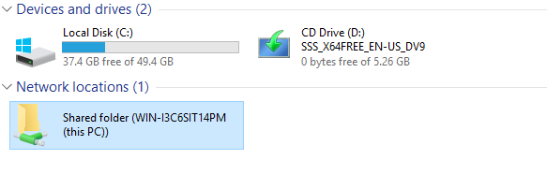

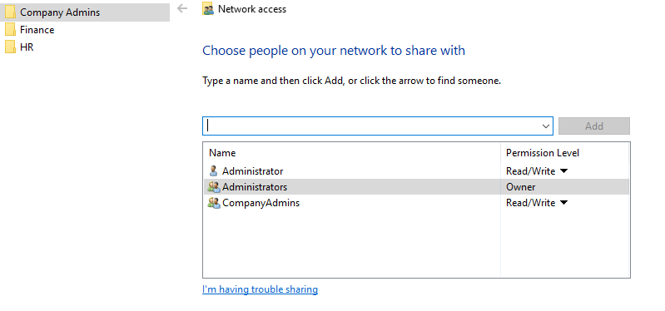
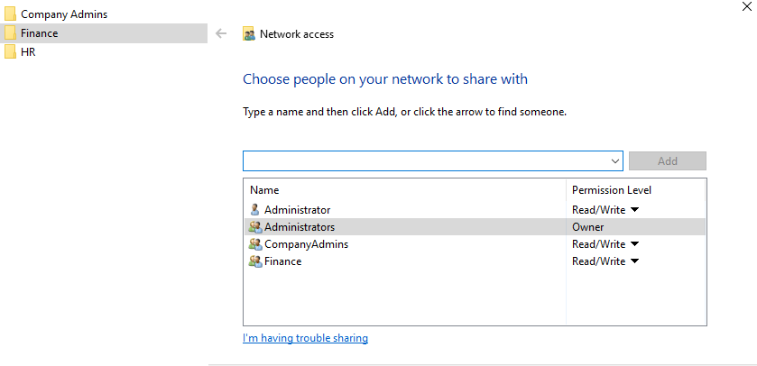
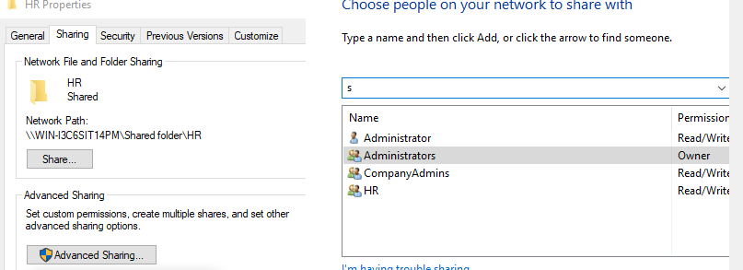
FILE SERVER - FOLDERS
Moving on to the last step of the project we created a shared folder that will be visible to all Groups , but each group will be
able to see the subfolder that corresponds to it ,and not subfolders from other groups. Only Company Administrators can see
all shared subfolders.
Shared folder
Subfolders
COMPANY ADMINS
FINANCE
HR

Slide 18
WE APPRIACIATE YOUR TIME!

Slide 19
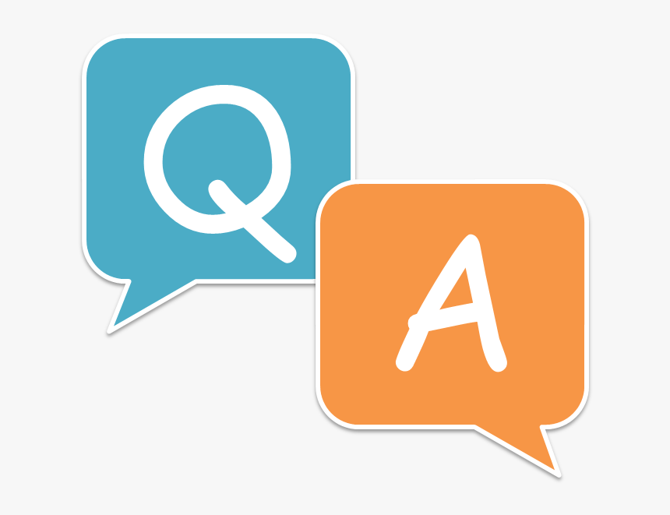
QUESTIONS

